Slide 1




JB
Yangon Smart City
Project
JUNE 2020

Slide 2


JB
This project's Agenda
OVERVIEW
Work-from-home best real-world project
Completed projects
Improving Code
Projects in Pipeline
Words to Page Myanmar
2020 © Julian Bharadwaja

Slide 3


Project Update
JB
WHERE WE ARE TODAY
Project have been created based on blog and job searching application using PHP PDO. This project can be improved to either way for both blogging application or job searching application.
Admin Panel can also be improved! For Example, adding or editing new post/event/theme/project/request like a word-press editing panel by using libraries and framework.
This project can be written by using Laravel Framework.
2020 © Julian Bharadwaja

Slide 4

JB
Yangon Smart City UI/UX Design Plan
Admin Panel
UI/UX Design For User Interface
LOGO And Photoshop
Admin Panel are designed based on Bootstrap Framework. It is purely used part by part from its libraries.
Both admin-site and user-site YGSC logos are drawn with Adobe illustrator 2020 and all background photos have been edited with Adobe Photoshop 2020.
Client-side UI is designed both wire-frame and the web/mobile app thoroughly by Adobe XD. It is carefully executed by pure HTML, CSS, JavaScript and jQuery.
2020 © Julian Bharadwaja

Slide 5
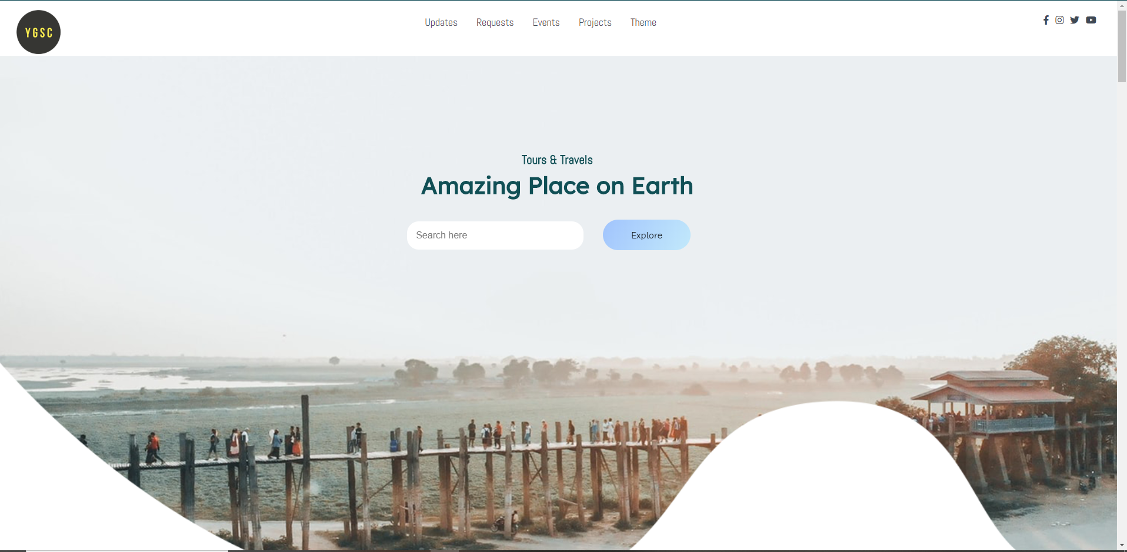
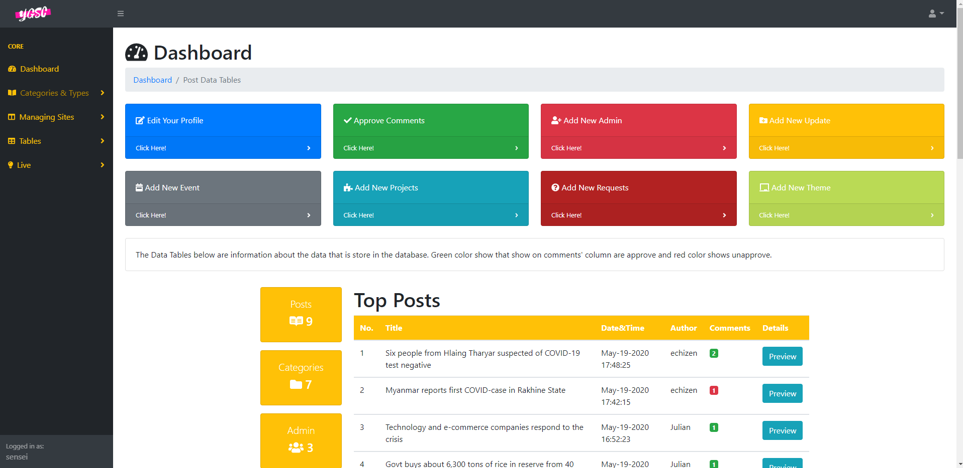
JB
Yangon Smart City UI/UX Design Plan
2020 © Julian Bharadwaja

Slide 6
Yangon Smart City Project Guidelines
Only for PHP above 5.6
Internet
Import the database name 'ygsc' to see the application
In order to use this application or system, please turn on the internet. Otherwise, Most of them can't be used.
This project is created on latest wamp software application and all the PHP codes are can be used for all version. It is recommended to use above 5.6 to experience to fullest
Database in sql file types are clipped with the documents.
JB
2020 © Julian Bharadwaja

Slide 7
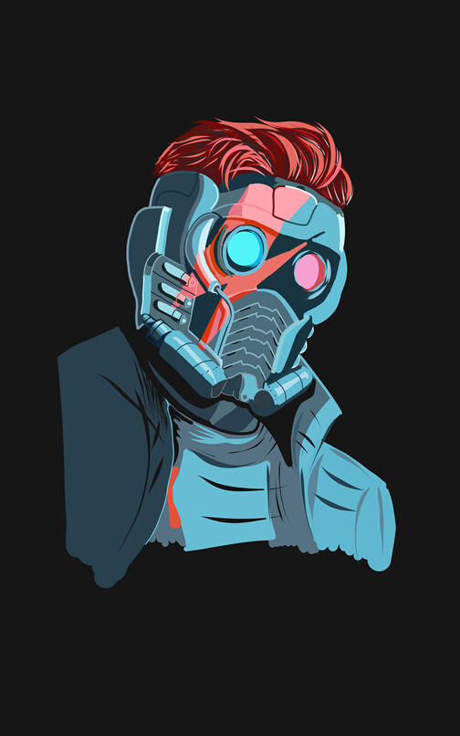

Yangon Smart City
JB
GENERAL BENEFITS
Responsive UI both client-side and server-side
Ads for Business
Can Be Added in Adds Panel
All screens can be used. From 4K screens to 300px mobile screens
Easy CRUD Application for Non-Programmer Peoples
All Types of Admin can be managed. User Friendly Application
2020 © Julian Bharadwaja

Slide 8


MESSAGE FOR PAGEMYANMAR
Thanking you from the bottom of my heart for all the efforts put in training me to fully understand the web engineering course, the best teaching that I have ever experienced throughout my learning period, your coaching have truly motivated me to understand and create web applications.
2020 © Julian Bharadwaja

Slide 9

Projects Completed
PHP Project: CMS Blog
CRUD Blogging Application both cilent and server side
JavaScript Project: Google Store Locator ($5,700 on Fiverr)
Created by using Google Map API and Restaurant API.
Django Project: Restaurant Reservation System
Created by using Django Framework.

Slide 10
Projects In
The Pipeline
JB
Student And Teacher Managing System Project
E-commerce Project
Legend of Zelda Gaming Project
This project is currently created by PHP 7.0. The Front-End Languages are HTML, CSS, JavaScript and the framework is VueJs. The Back-End is PHP.
This project is currently created by JavaScript. The Front-End Languages are HTML, CSS, JavaScript and the framework is React. The Back-End is nodejs.
This gaming project will be available both iOS and Android. This project is written by C# and written on Unity. The designs are drawn on blender. Already created Dungeon Level.

Slide 11


Challenges
Pagination And Filtering System
App Development
Will be improving on those parts in more efficient and professional ways.
It has been planned thoroughly to create a stunning web application,
Security Protection For Web
I have carefully built the log in security system by using regular expression.
I have also implemented PDO on the data input table to protect the database from suspected scripts.
JB

Slide 12

Final Reminders
JB
Internet Need!
Honor
Video
Coding
It would be my pleasure and honor if you could showcase my web applications, comments and my portfolio on your web page.
I have also made a video on my Yangon Smart City web application and hope to get your satisfaction.
All files and codes are clearly refactor and commented.

Slide 13
JB
Thank you!
Check Out My Portfolio - https://myportfoliowebsitejulianbharadwaja.imfast.io

